Slide 1
Education can unlock big change
Slideshow for Educators
Notes:
This slideshow is designed for use alongside the Education can unlock big change activities for ages 7-16.
These cross-curricular activities help learners to appreciate the power of education in unlocking big change.
Learners will think about their hopes and aspirations for the future and what changes they would like to see happen in the world. They will learn about the Sustainable Development Goals (SDGs), the set of global goals and targets aimed at making our world a better place, and investigate the importance of education in achieving these goals. In the final activity, learners are encouraged to creatively share their ideas about how education can unlock big change.

Slide 2
Activity – Imagining the future

Slide 3
Imagine you could travel forwards in time to 2030.
Notes:
Ask learners to imagine that they were able to travel forwards in time to 2030.

Slide 4
What changes would you like to see happen?
What would you like the world to be like?
How would you be feeling in this ideal world of the future?
Notes:
Ask learners what they would like the world to be like in 2030. What changes would they like to see happen? How would they be feeling in their ideal world of the future?

Slide 5
Issue
Issue
Your ideal future
Issue
Issue
Notes:
Organise learners into groups of three or four. Give each group a large piece of paper and ask learners to draw a big circle on it to represent the world.
Ask learners to fill this outline of the world with words and pictures to show what their ideal future would be like. Alternatively, they could cut out pictures from newspapers or magazines to create a collage to illustrate their thinking.
Now ask learners to use words or draw pictures to describe what they think the big issues in our world are. They should record these ideas in the space around their world.

Slide 6
Which of these changes do you think are most likely to happen?
Do you think others
share your hopes
for the future?
Which of these changes do you think is most likely to happen?
Which of these changes do you think are most likely to happen?
What action is needed to create this ideal future? Who needs to be involved in taking action?
Which of these changes do you think is least likely to happen?
Notes:
Encourage learners to talk about their ideas in their group before discussing their thoughts as a class. Possible discussion questions are provided on this slide.

Slide 7
Activity – Education can unlock big change

Slide 8
Notes:
Ask learners whether they have heard of the Sustainable Development Goals.
Explain that in 2015, countries all over the world came together to commit to the Sustainable Development Goals. The SDGS, also known as the Global Goals are a set of goals and targets aimed at making the world a better place by 2030. The goals apply to everyone, young or old, in all the 193 countries that signed up to them.
Say that many people around the globe have been working towards these goals. A lot of progress has been made but there is still much more to be done and the Covid-19 pandemic is pushing back some of the progress that has been made.

Slide 9
Each goal needs all of the other goals to make it happen!
Notes:
Explain that an important fact about the 17 SDGs is that they are all interconnected – none of the goals can be achieved on its own without the support of the other goals.

Slide 10
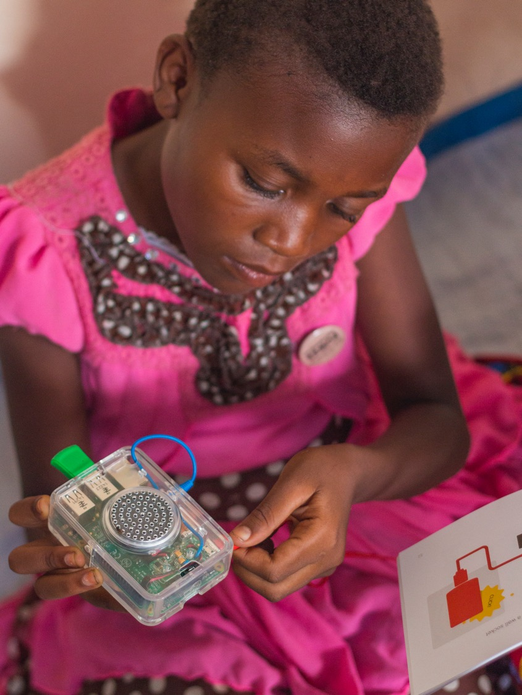
What does education mean?
How do you learn?
Where do you learn?
When do you learn?
Who helps you to learn?
We all learn in lots of different ways throughout our lives.
Notes:
Discuss learners’ thoughts and ideas about what education means. Ask them to think about how, where and when they learn and who might help them to learn? Make the point that education isn’t just about going to school, we learn in lots of different ways throughout our lives.

Slide 11
How can education help to achieve the Global Goals?
Notes:
Briefly discuss any initial ideas that learners might have about how education can help to achieve the Global Goals. You could prompt them by asking them to consider specific SDGs. For example, how do you think education could help the world to take climate action (SDG10)? How could education support SDG1 – No poverty?

Slide 12
distribute food - many children in the UK and around the world have their main meal at school
Notes:
Give each group a copy of the Education can unlock big change activity sheet and ask learners to cut out the statements. Explain that these statements describe some of the possible consequences of education. Learners need to stick the statements on the paper and draw lines to the goal or goals they think this consequence will help to achieve. Say that there are no right or wrong answers; the main aim of this activity is to just get learners thinking about the importance of education.
For example, distributing food at school could help to achieve SDG2 (zero hunger) and SDG3 (good health and well-being). Learners may be able to think of other goals this consequence of education might help to achieve.
Encourage learners to then add their own ideas of how education could help the SDGs to be achieved. They should write or draw their ideas on the paper around the SDG icons, drawing lines to the relevant goal or goals as before.

Slide 13
Activity – Making the case for education (11-16)

Slide 14
Where does the money for education and schools come from?
Notes:
Ask learners where they think the money for education comes from. For things like building and maintaining schools, paying teachers and buying equipment such as books and laptops. Explain that a country’s government will produce a budget. This is a financial plan which sets out how public money (raised through taxes and other sources of income) will be spent. In the UK this process usually happens once a year.

Slide 15
Social protection
Defence
Industry & Agriculture
Public order and safety
Education
£
Debt interest
Health
Employment
Housing
Transport
Environment
Notes:
Explain that different amounts of money will be allocated to areas such as education, health, defence, transport, housing and the environment. Different countries will choose to spend the money in different ways. Some will decide to spend more on education and some will choose to spend less.

Slide 16
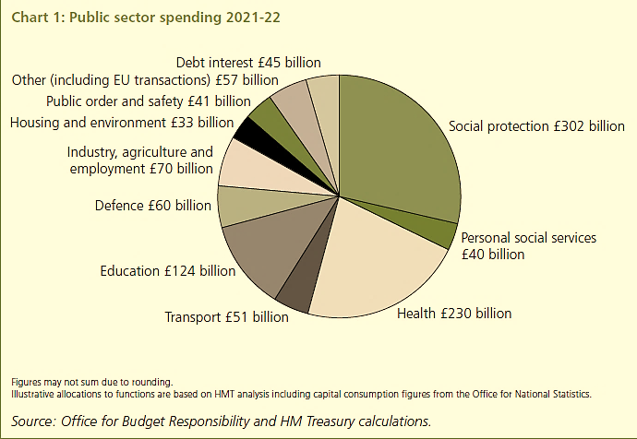
Notes:
Ask learners what percentage of the UK budget they think is spent on education. Share that in the 2021/22 financial year the UK government is planning to spend about 12% (£124 billion) of public money on education.
Discuss learners’ responses to this budget allocation. Do they agree with it? What would they spend more or less money on?
Source: https://www.gov.uk/government/publications/budget-2021-documents

Slide 17
Making the case for education
How would you persuade a government to spend more money on helping children and young people to learn?
What reasons will you give to support your case?
How will you present your ideas?
Slide for ages 11-16
Notes:
Ask learners to imagine they are a team of advisers to the government of a fictional country. They need to work in together in their group to make a case for education – to persuade a government to spend more of the country’s money on education.
Tell learners that they need to come up with strong reasons to support their case. They could use the statements in the Education can unlock big change activity sheets to help them. Learners could also carry out their own research to identify other reasons (see the useful links and resources).
Explain that learners will also need to decide how to present their ideas. Each group could allocate a spokesperson (or spokespeople) to present their case to the rest of the class. Alternatively, groups could create an infographic, video or presentation.

Slide 18
© Theirworld 2021. All rights reserved.

