Slide 1
Education unlocks good health and well-being
Slideshow for Educators
Notes:
This slideshow is designed for use alongside the Education unlocks good health and well-being activities for ages 7-16.
In these activities learners will explore some of the actions individuals can take to improve their own health and well-being, as well as that of others around them. They will think critically about how education can unlock good health and well-being and find out how a Theirworld project improved the well-being of vulnerable children during the Covid-19 pandemic. In the final activity, learners are asked to design their own well-being pack with ideas, tips and activities for promoting good health and well-being.

Slide 2
Activity – What do good health and well-being mean?

Slide 3
What do good health
and well-being mean?
Notes:
Talk with learners about what they think ‘good health and well-being’ means. Ask them to discuss their ideas with a partner before talking together a whole class.

Slide 4
Health is all the things we can do to take care of our bodies
Well-being is about feeling comfortable, healthy and happy
Notes:
Explain that well-being can be described as ‘the state of being comfortable, healthy and happy’. We can think of good health as all the things we can do to take care of our bodies.

Slide 5
Notes:
Organise learners into groups of three or four. Give each pair or group a large piece of paper.
Ask learners to draw a big outline of a person in the middle of the paper and fill it with words and pictures to show different ways in which we can look after our health and well-being.
Possible ideas could include washing your hands properly, eating a balanced diet, exercising regularly, getting enough sleep, brushing our teeth and talking about our feelings. Remind learners that different people have different things that make them happy and so some of their ideas may be personal to them. However, we know from science and medicine that there are many things that can help everyone to improve their health and well-being (as well as some things that can be bad for our health and well-being).

Slide 6
Activity – How can education unlock good health and well-being?

Slide 7
How can education unlock good health and well-being?
Taking part in sports at school can encourage people to be physically active.
Education can train scientists to develop vaccines and treatments to fight pandemics.
Schools can provide safe spaces for children and young people to talk about their feelings.
Notes:
Organise learners into groups of three or four. Ask them to take turns at suggesting a way in which we look after our health and well-being and then discussing as a group how education might help support this.
Some examples are provided on this slide.

Slide 8
Education can train engineers to design and build water treatment plants
This reduces the risk of people catching and spreading some diseases
People have clean water to drink
This helps people to be healthy
Notes:
Distribute copies of the Education unlocks good health and well-being resource sheets. Ask learners to read and discuss the statements in their groups before talking about them as a class.
For each statement, support learners to understand the link with education as well as what the impact on health and well-being might be. An example is provided on this slide.

Slide 9
Activity – Making my well-being pack (7-11) Activity – My well-being calendar (11-16)

Slide 10
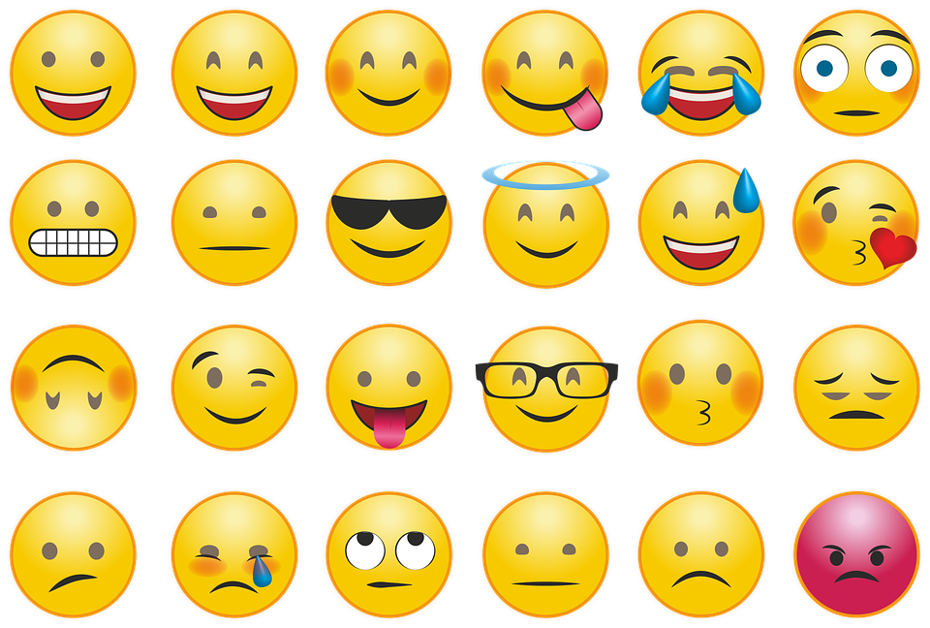
Challenge
You have one minute to think of as many different emotions as possible!
Notes:
Give learners one minute in pairs to think of as many different emotions as possible. Learners could record their ideas digitally or on paper or sticky notes. Feedback together as a class.
Explain that every day we feel lots of different things for different reasons and this is perfectly normal. At times we might feel happy or excited. At other times we may feel sad, anxious, worried or angry at times. Often we will have a combination of feelings. For example, we might feel excited and anxious before the first day of a school term. Some feelings are experienced as comfortable and some as uncomfortable.
Ask learners to think about times when they have experienced different emotions. What happened to make them feel like this? Invite learners to share their ideas with the rest of the class if they wish to.
Point out that there are many different things that affect how we feel. All of us will have to cope with changes, challenges and uncertainty at times. Some of these events or changes can feel overwhelming. Although we can’t always change some of the events that happen in our lives, there are some things that we can control more.

Slide 11
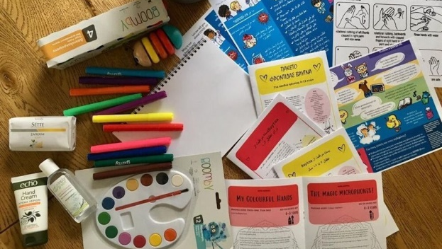
Giving out well-being packs
Notes:
Covid-19 has affected the lives of everyone. Many children and young people have been feeling anxious - about their schools being closed, not seeing their friends and uncertainty over the future.
A Theirworld project has helped 1,000 children in Turkey to cope better with the difficulties of being forced to stay at home by the pandemic - often without computers, mobile phones or internet access for remote learning.
Maya Vakfı, a Turkish organisation, has been handing out art and crafts packs to the children. Turkey hosts more refugees than any other country and many of the children receiving the packs are Syrian refugees. These young refugees have already faced challenges in their lives after being forced to flee their homes because of conflict. Covid-19 has made their lives even more difficult. Some of the children were alone at home while their parents were at work, or their parents were working from home and could not help them with their learning.
The packs include paints, coloured crayons, felt markers, a drawing book, a pencil case, play dough and stickers. Painting, drawing and being creative can help the children if they are feeling anxious or worried.

Slide 12
How do you think these children might have felt by being forced to stay at home because of Covid-19?
How might going to school help children’s well-being?
How do you think it might feel to suddenly have to leave home?
Notes:
Use the case study on slide 11 to prompt discussion about how different things can affect our well-being as well as possible actions people can take to help our well-being.
Here are some suggested discussion questions:
How do you think these children might have felt by being forced to stay at home because of Covid-19? Millions of children in the UK and around the world have been affected by school closures related to Covid-19. If learners have experience of missing school as a result of Covid-19, they might like to share how they felt during this time.
How do you think it might feel to suddenly have to leave home? Many children also face other challenges which can make their lives difficult. The children in the case study may have experienced the trauma of fleeing conflict and being forced to leave their homes, schools and communities to start a new life somewhere else.
How might going to school help children’s well-being? For example, going to school can help improve children’s well-being by providing a routine, a chance to be with friends and hope for the future.

Slide 13
My well-being
Notes:
Say that as well as painting and drawing there are many things that we can do to help our well-being. Invite learners to share ideas of activities that might help. Record their ideas on a board or large piece of paper.
It may be useful to prompt learners to think about things that have helped them to cope with challenges in the past. Or to think about things they have heard, seen or read about from others. Remind learners that some of their suggestions might be personal to them and that’s okay. Different people may have different things that help their well-being, but there will also be things that can be helpful for many people.

Slide 14
Well-being activity ideas
Get some fresh air outside
Take five deep breathes
Talk to someone about
how you’re feeling
Write down three things you are grateful for
Help someone else
Do some exercise
Learn something new
Notes:
Some suggested activities are provided on this slide and in the Well-being activity ideas resource sheet.

Slide 15
What would you put in a well-being pack?
Photos of people (or pets) who make you happy
Favourite toy
A healthy snack
Some
playdough
A list of people you could talk to
Pieces of Lego
Photos of your favourite place to be
A colouring book and pencils
Slide for ages 7-11
Notes:
Additional slide for ages 7-11
Explain that learners are now going to design their own well-being pack filled with things that might help them to feel happy, healthy and comfortable. Discuss their ideas about what the contents might be. Some suggestions are provided on this slide.
Invite learners to share their well-being pack with others in the class if they would like to. As an extension activity, learners could make a pack of actual items to keep at home or school. Alternatively, they could design and make a pack to give to a younger sibling or a child in another class at school.

Slide 16
Design a well-being calendar
1 | 2 | 3 | 4 | 5 | 6 | 7
8 | 9 | 10 | 11 | 12 | 13 | 14
15 | 16 | 17 | 18 | 19 | 20 | 21
22 | 23 | 24 | 25 | 26 | 27 | 28
29 | 30 | 31
Write an idea in each square for something that you could do each day to look after your well-being.
Slide for ages 11-16
Notes:
Additional slide for ages 11-16
Explain that learners are now going to create a well-being calendar for a month. They need to think of a well-being activity idea for each day. Learners could design their own calendar on a large piece of paper. Alternatively they could use the template provided in the Well-being calendar activity sheet.
Invite learners to share their calendar with others at the end of the activity if they would like to. Encourage learners to display their calendar somewhere where they can easily access it each day. For example, they might want to stick it up in a bedroom or inside their school journal.

Slide 17
© Theirworld 2021. All rights reserved.

