Slide 1
Education unlocks skills and employment
Slideshow for Educators
For ages 7-11
Notes:
This slideshow is designed for use alongside the Education unlocks skills and employment activities for ages 7-11.
These fun and easily-adapted activities help young people to develop the skills they need to be effective change makers in their lives, their communities and the world around them.
Learners will consider their own personal skill set and work collaboratively to rank different types of skills. They will find out about the Sustainable Development Goals and imagine a job of the future that could help one of these global goals to be achieved. Learners will investigate how we learn skills and identify things that can support this learning process, as well as potential barriers. In the final activity, learners are asked to choose a skill that they would like to develop and create a toolkit to help support this learning.

Slide 2
Activity – Thinking about my skills

Slide 3
What is a skill?
What skills have you learned during your life?
Notes:
Discuss with learners what is meant by a skill. Explain that we can think of a skill as a particular ability or type of ability to do something.
Invite learners to give examples of different skills that they have learned during their life. This might be things that they learned how to do in the first few years of their life (such as walking or talking). It might be skills they have learned at school, at home or elsewhere in their community.
Say that every person has their own set of skills that makes them unique. We learn skills by training, experience and practice. We will all have some skills that we are better at than others. Sometimes we might be naturally good at a particular skill, but we can still get better by practising it. We carry on learning new skills (and developing existing skills) throughout our lives.

Slide 4
Decorate your hand to show all the amazing skills you have!
Notes:
Ask learners to think about what skills they have. Give each learner a piece of paper and ask them to draw an outline of their hand on it. Explain that learners need to decorate their hand with words and pictures to show some of the skills they have.

Slide 5
Thinking about my skills
caring for others
solving problems
working on my own
swimming
coding
cooking
leading others
being adaptable
coming up with ideas
working in a team
managing my feelings
writing
speaking
listening
Notes:
The list of possible skills on this slide and in the My skills resource sheet could be used to prompt learners’ thinking.
Invite learners to share their ideas with others. Their hands could be used to create a ‘Skills display’ in the classroom.

Slide 6
Activity – What skills are important?

Slide 7
What skills might be important…
…for helping you to get on with others?
…at home or in other parts of your life?
…at school?
…for our world in the future?
…for your life in the future?
Notes:
Ask learners what skills they think are the most important to have in life. Ask learners to talk with a partner before sharing their ideas as a whole group. Possible questions to prompt their thinking are provided on this slide.

Slide 8
adaptability
teamwork
resilience
critical thinking
What skills are important?
organisation
interpersonal
problem-solving
creativity
communication
Notes:
Organise learners into groups of three or four. Give each group a copy of the Sorting skills activity sheet. These skill types are also provided on this slide. Talk through the meaning of each of these skills to check learners’ understanding.
Say that learners are going to work together in their groups to think about the importance of these different skill types.

Slide 9
Most important
Least important
Notes:
Explain that learners should cut out the skills cards and sort them into a diamond. The skills that learners think are the most important should go at the top of their diamond. The skills they think are less important should go at the bottom. There are three blank cards on the activity sheet in case learners want to replace some of the skills with their own ideas.
Say that there is no right or wrong way of doing this but learners need to agree as a group and have reasons for why they chose this order.
Allow time at the end of the activity for learners to share and talk about their ideas with other groups. Learners could also reflect on and discuss what skills they have developed through taking part in this group-based activity.

Slide 10
Activity – Jobs for an ideal future

Slide 11
Notes:
Ask learners whether they have heard of the Sustainable Development Goals. Learners are introduced to these goals in the Education can unlock big change activities for ages 7-11.
Explain that in 2015, countries all over the world came together to commit to the Sustainable Development Goals. The SDGS, also known as the Global Goals, are a set of goals and targets aimed at making the world a better place by 2030. The goals apply to everyone, young or old, in all the 193 countries that signed up to them.

Slide 12
How old will you be in 2030?
What might you be doing in 2030?
Which of these changes do you think are most likely to happen?
Notes:
Ask learners to work out how old they will be in 2030. Point out that in 2030, learners might be old enough to be working. Or they might be studying or training for a future career. Invite learners to share their thoughts about what they might be doing in 2030 with a partner. What job might they have? What would they like to be studying or in training for?
Say that it is likely that many children at primary school today will have a job in the future that doesn’t exist yet. Similarly, many of the jobs people do today didn’t exist when their parents were children.
Discuss learners’ ideas about why they think this is.

Slide 13
Many jobs are changing because of automation – using technology to do things that people used to do before.
Notes:
Explain that one of the reasons for this is automation – using technology to do things that people used to do before. Automation means that some existing jobs won’t be needed in the future but other jobs will be created to support these technological changes.
Ask learners for examples of things we use technology for such as buying and selling things online, virtual learning or making things in factories. You might like to extend this discussion by asking learners to reflect on how they think our use of technology has changed during the Covid-19 pandemic.
Explain that new jobs are also needed now and in the future to tackle the challenges facing our world and achieve the SDGs.

Slide 14
Imagine a job of the future that could help to achieve one of the SDGs.
Notes:
Ask learners to each choose one of the SDGs and think of a job in the future that could help to achieve this goal. They should draw an annotated picture to describe what this job will be like and what global problem it will help to solve.
Encourage learners to be as creative as possible and imagine a world where anything is possible. Perhaps they could be an engineer who develops a new way of using renewable energy (SDG7 – Affordable and Clean Energy) or a computer programmer who controls drones that fly around removing carbon dioxide from the atmosphere (SDG10 – Climate action) or a scientist who finds a cure for malaria (SDG3 – Good Health and Well-being).

Slide 15
Which goal (or goals) will your job help to achieve?
How will your job help to achieve the SDGs?
What skills do you think a person doing this job will need?
Would you like to do this job?
Notes:
Allow time for learners to share their imaginary jobs with others. Some suggested discussion questions are provided on this slide.

Slide 16
Activity – My toolkit for learning skills

Slide 17
Where did you learn this skill?
Who or what helped you to learn it?
Which of these changes do you think are most likely to happen?
What might make it difficult to learn a new skill?
Notes:
Ask learners to think about one of the skills they have and discuss with a partner (or in a larger group) how they learned this skill. Additional information to prompt this thinking and discussion is provided below:
Where did they learn this skill? We learn skills in lots of different places – at school, online, at home or in other places in our community. We are learning skills all the time throughout our lives.
Who or what helped them to learn this skill? For example, this might be other people teaching or showing us how to do something, or offering them encouragement. It might be having the necessary equipment, space or time to learn and practice a skill. It might be having self-belief and motivation to keep going and practice a skill.
What might make it difficult to learn a new skill? We will all have some skills that we naturally find easier to do or learn. There will also be some skills that we enjoy learning more than others. However, there may also be other things that can make it more difficult. For example, we might not have the equipment, space or time we need to learn a skill or someone to teach us how to do it.

Slide 18
260 million children are out of primary and secondary school today
75 million have their education interrupted by conflicts, emergencies and disaster.
Notes:
Say that many young people around the world don’t have the skills they need for life and work in the future. Share the facts on this slide and explain that things like living in poverty can make it more difficult to have the opportunity to go to school and learn skills. Girls, refugees and children with disabilities are all more likely to be out of school and missing out on learning.

Slide 19
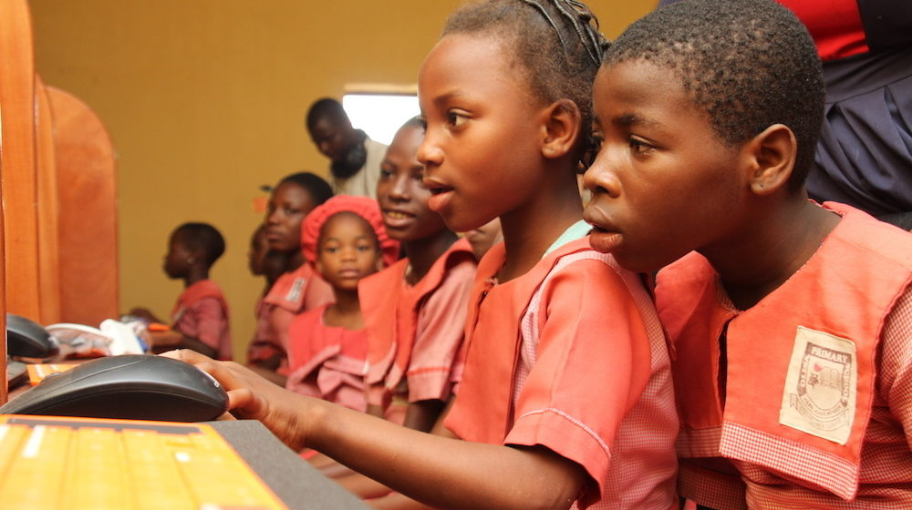
Setting up code clubs
Notes:
Digital skills are very important in our lives and we will need them even more in the future. We use digital skills in lots of different ways such as to buy and sell things, find things out and communicate with other people.
But some things can make it more difficult for young people to learn the digital skills they need. Some young people might not have the chance to learn skills because they have to work or help out at home. Or some young people might not have the equipment they need to learn or people to help them. Poorer families might not be able to afford an internet connection or a digital device such as a laptop or computer. Some people might live in remote areas without reliable internet coverage.
Theirworld has been working with partner organisations to set up Code Clubs to help to help some girls and young women learn digital skills. 1300 students aged 6-25 have taken part in Tanzania, Uganda, Zimbabwe, Kenya and Nigeria and Lebanon.
The Code Clubs provide a safe place for the girls to learn, play and create. In the clubs, the girls learn how to build a computer, make games and artwork, and use code. The older girls also learn how to build their own websites as well as gaining skills for to help them get jobs or set up their own business in the future.
Photo credit: Theirworld/Olusola Ileoba

Slide 20
Where and when will
I learn this skill?
What things will I need?
What skill would I like to learn?
Who can help me
to learn this skill?
What else might help
me to learn it?
Notes:
Ask learners to think of a skill that they would like to learn. This might be a new skill or a skill that they already have but would like to be better at.
Explain that learners are going to each create a toolkit to help them to learn this skill. Ask learners to think about where and when they might learn this skill, what support they might need and who might be able to help them. Learners could share their ideas with a partner.
Give each learner a copy of the My toolkit for learning skills activity sheet to complete using words or pictures.

Slide 21
© Theirworld 2021. All rights reserved.

