Slide 1
Education unlocks opportunities for girls
Slideshow for Educators
Notes:
This slideshow is designed for use alongside the Education unlocks opportunities for girls activities.
These cross-curricular activities for ages 7-16 help learners to think critically about some of the reasons why so many children and young people (and girls in particular) are still denied the chance to go to school. Learners will consider the impacts of gender stereotyping on people’s lives and think about what action they could take to help make life fairer for everyone, whatever their gender.

Slide 2
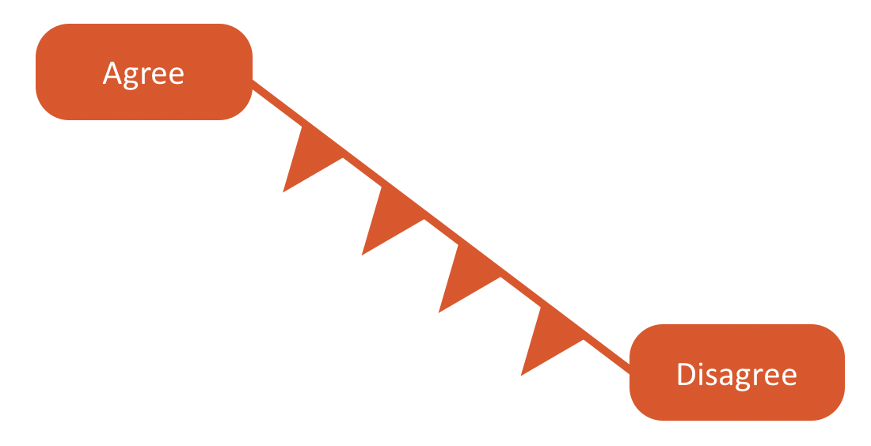
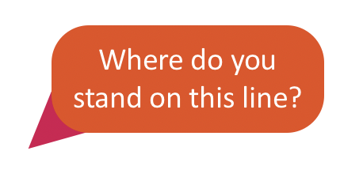
Agree or Disagree?
Notes:
Ask learners to imagine a line from one side of the space to another. Teachers may wish to label one side of the space ‘agree’ and the other side ‘disagree’.

Slide 3
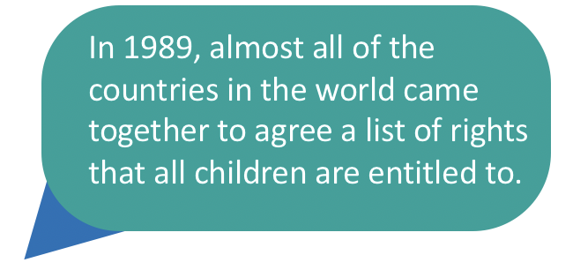
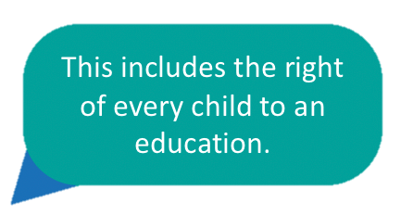
UN Convention on the Rights of the Child
Notes:
In 1989, almost all of the countries in the world came together to agree the United Nations Convention on the Rights of the Child. This convention contains 54 articles that cover all of the rights that children everywhere are entitled to. Article 28 states that every child has the right to an education.
Find out more: https://www.unicef.org.uk/what-we-do/un-convention-child-rights/

Slide 4
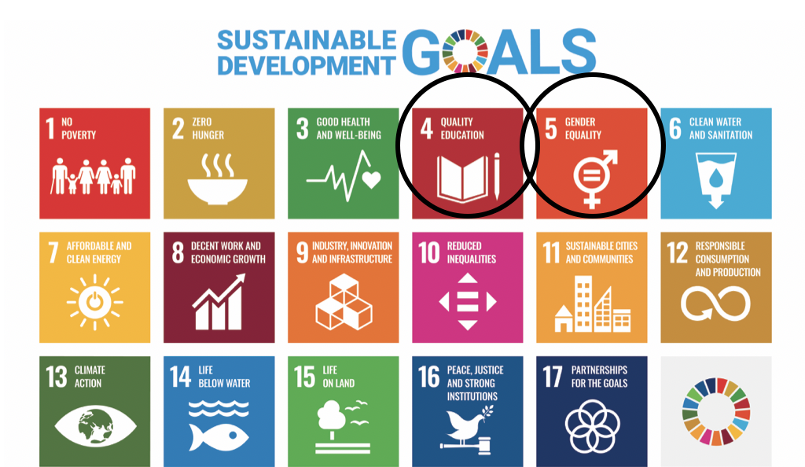
Sustainable Development Goals
Notes:
Making sure that quality education is available to all is also one of the Sustainable Development Goals (SDG 4), the set of global goals and targets aimed at making the world a better place. Education is critical for all of these goals to be achieved by 2030. SDG 5 is focused on achieving gender equality and empowering all women and girls.
Find out more: https://www.globalgoals.org/goals

Slide 5
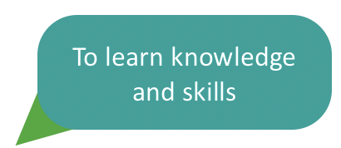
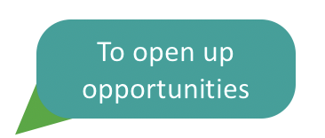
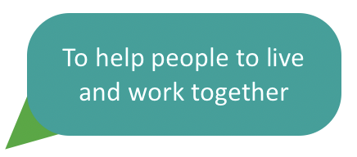
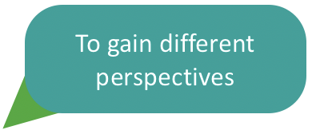
Why is education important?
Notes:
Education is important in lots of different ways. It gives children the best start in life, helping them to develop the knowledge and skills they need for the future. It strengthens communities and helps people to work together to tackle the big challenges our world faces such as climate change.

Slide 6
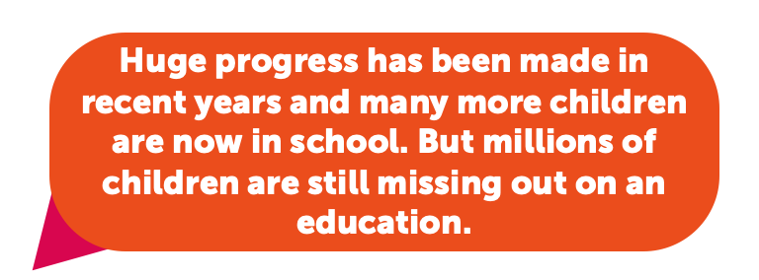
Children out of school
Notes:
Huge progress has been made in recent years and many more children and young people are now in school. But, some countries have made much less progress than others and the impacts of Covid-19 have pushed back some of the progress that has been made. Globally, 244 million children (aged 6-18) are out of school.
Data source: https://world-education-blog.org/2022/09/01/new-measurement-shows-that-244-million-children-and-youth-are-out-of-school/

Slide 7
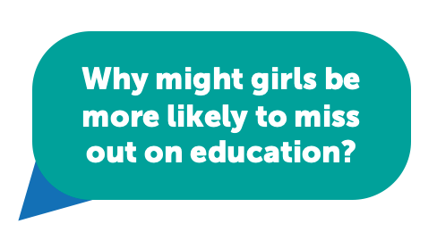
Barriers to girls’ education
Many of the barriers to education affect children of all genders. But in some parts of the world, girls are much more likely to be out of school.
Notes:
Millions of children around the world are missing out on an education. Many of the barriers to education affect children of all genders, but in some parts of the world girls are much more likely to be out of school. A lot of progress has been made to make sure that every girl is able to go to school but this improvement hasn’t been seen everywhere. Where a girl lives in the world can make a big difference in their chances of getting an education.

Slide 8
Draw a person doing one of these jobs.
Notes:
Ask learners to draw a person doing one of these jobs (teacher, firefighter, construction worker and nurse). Explain that learners should just do a quick sketch, they could use stick people if they want. Alternatively, learners could be asked to come up with any words they would use to describe one of these careers (these could be written or shared verbally).

Slide 9
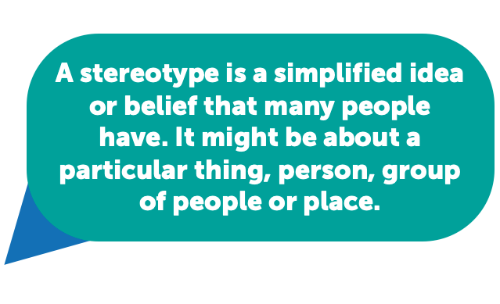
What is a stereotype?
Notes:
Use this slide to support discussion about what stereotypes are.

Slide 10
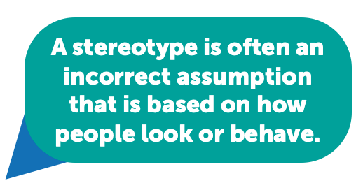
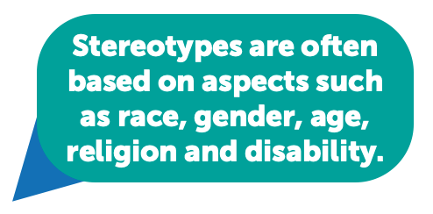
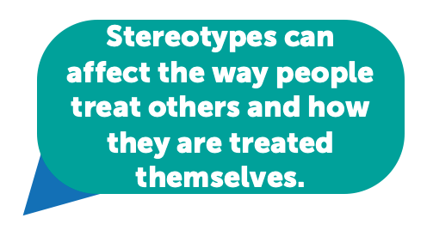
What is a stereotype? (2)
Notes:
Use this slide to support discussion about what stereotypes are. Invite learners to share any examples of stereotypes they are aware of. If learners, feel comfortable, they may like to share any personal experiences they have had of being stereotyped.

Slide 11
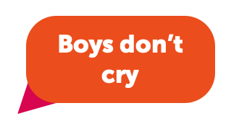
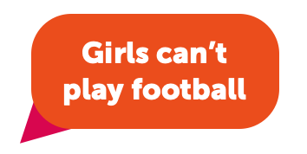
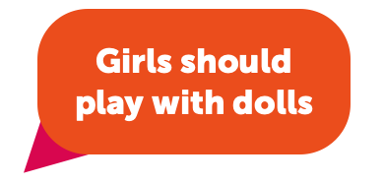
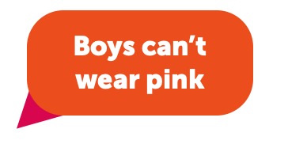
Can you think of any examples?
Notes:
Gender stereotypes are commonly held views about how a person should be or act based on the gender they are perceived to be. Invite learners to share any examples of gender stereotypes they have heard of.

Slide 12
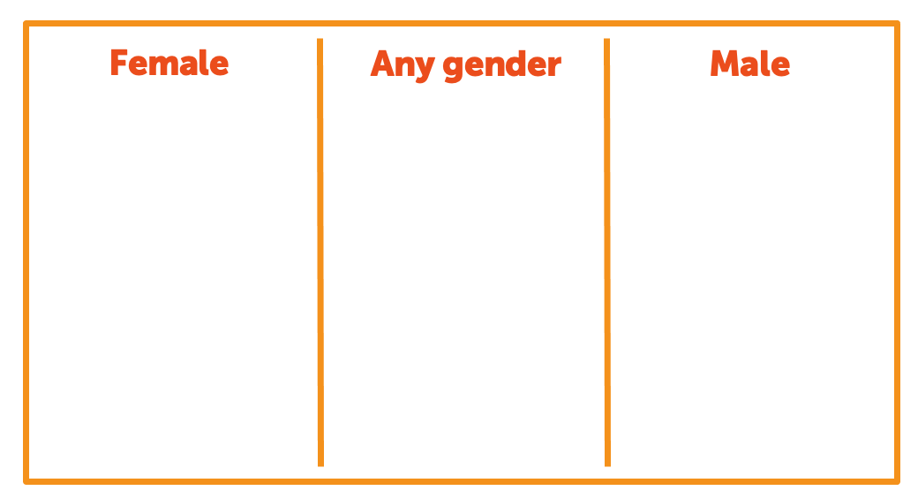
Gender activity
Notes:
Ask learners to divide their sheet of paper into three columns, with the headings: ‘Female’, ‘Male’ and ‘Any gender’. Note that there are many other gender identities and teachers may wish to include other gender identities in this sorting activity.

Slide 13
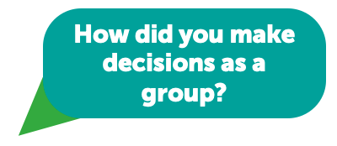
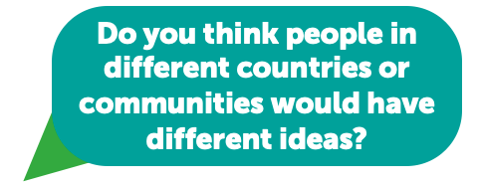
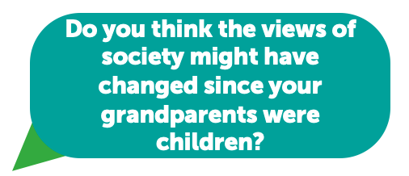
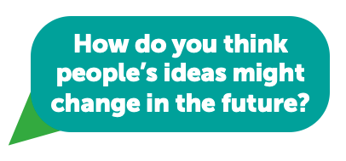
Discussion time
Notes:
These questions could be used to support follow-up discussion about the sorting activity.

Slide 14
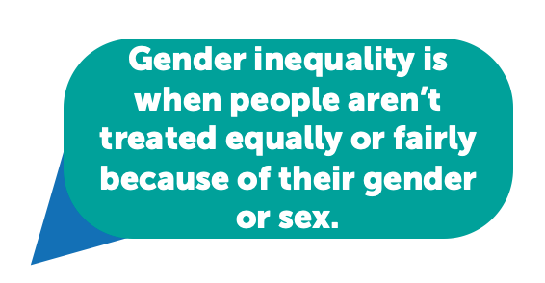
What is gender inequality?
Notes:
Explain that stereotypes can lead to gender inequality – where people are treated differently and unfairly because of their gender or sex.

Slide 15
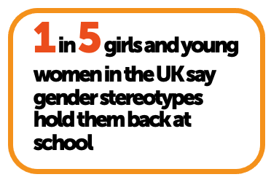
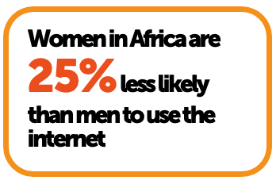
Thinking about gender inequality
Notes:
Data sources:
Only 3% of technology graduates globally are women:
https://www.weforum.org/agenda/2020/02/stem-gender-inequality-researchers-bias/
Just 9 of the CEOs in the FTSE 100 companies are women:
https://www.raconteur.net/leadership/tse-100s-first-female-leadership-team-overdue/
29% of people working in science, technology, engineering and mathematics in the UK are women:
https://www.gov.uk/government/news/more-women-to-be-supported-back-into-stem-jobs-in-government-backed-training
Women in Africa are 25% likely than men to use the internet.
https://www.unesco.org/gem-report/en/inclusion
1 in 5 girls and young women in the UK (aged 11-21) say gender stereotypes hold them back at school.
https://www.girlguiding.org.uk/globalassets/docs-and-resources/fundraising-and-partnerships/uk-snapshot-gas-2022.pdf

Slide 16
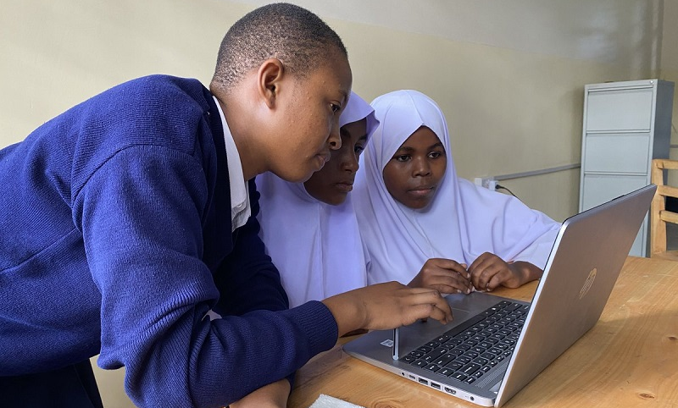
Skills for the future
Notes:
Women represent only 3 per cent of technology graduates globally. With Skills for the Future, Theirworld is working with others to help girls and young women aged 14-20 to develop digital, coding and entrepreneurship skills.
The girls in this photograph are finding out how to create and edit video and photography content at a school in Tanzania. In Tanzania, only 10% of students earning degrees in computer science are female. Only 25% of women have technology jobs.
Jennifer is one of the students who has taken part in Skills for the Future in Tanzania. She said: “Girls can change their lives and their community with these skills… “I shared the knowledge with my family because I wanted them to also understand. It helped my father to use his phone for finding materials online and my family in budgeting.”
Data sources:
https://www.weforum.org/agenda/2020/02/stem-gender-inequality-researchers-bias/
https://theirworld.org/news/girls-in-ict-day-2022-nurturing-tanzanian-girls-future-career-paths-in-stem/

Slide 17
How might gender stereotypes affect these rights?
Notes:
These questions could be used to support further discussion about the possible impacts of gender stereotyping.

Slide 18
How are gender stereotypes promoted?
Notes:
These examples of some of the ways in which stereotypes are promoted could be used as a discussion prompt.

Slide 19
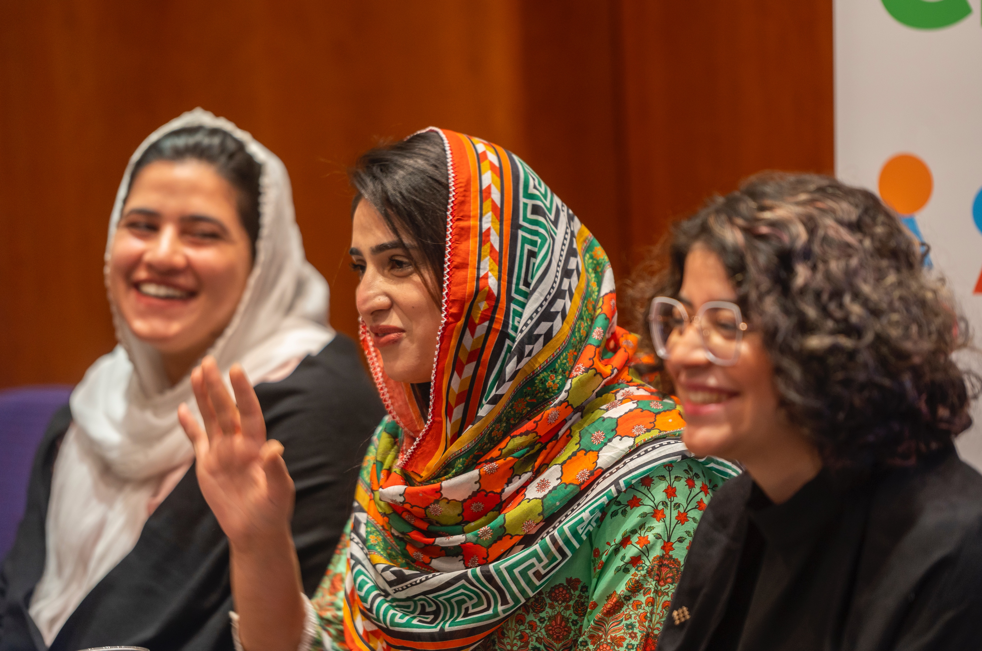
Speaking up for girls’ education
Notes:
Shazia Ramzan and Kainat Riaz are from Pakistan. The two young women, along with their close friend Malala Yousafzai, were injured when the Taliban, an Islamic group, attacked the school bus they were travelling on. Gender stereotypes about the roles of girls and women made it difficult for Shazia and Kainat to go to school. In neighbouring Afghanistan, the Taliban leaders have banned girls over the age of 12 from getting an education. Women have also been prevented from going to university.
Shazia and Kainat are now studying in the UK. They would like to be doctors one day. “For me, education is like a light – without light you can’t see anything,” said Kainat.
Shazia and Kainat are also determined to speak up for education, particularly girls’ education. They are Theirworld Global Youth Ambassadors. They are part of a worldwide group of young people who are campaigning for the right to education for every child, everywhere. Campaigning is about making change happen. It is about influencing others, thinking about what action is needed and identifying who is responsible for taking action.
Shazia explained: “You start with one person. If we can change the mindset of that one person, they can change the mindset of another person, maybe even in the same family, then others.”

Slide 20
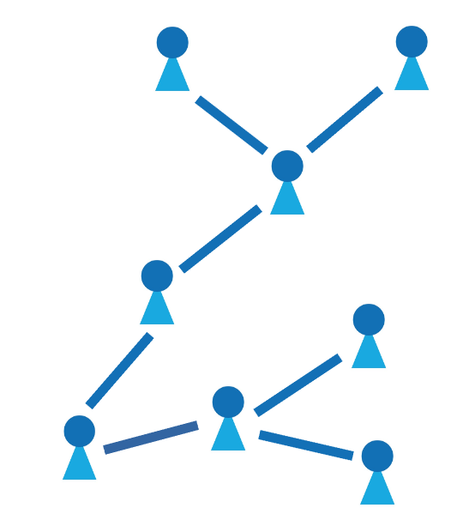
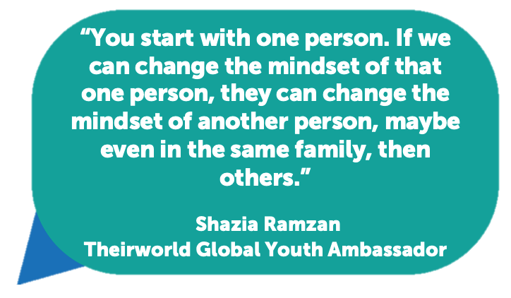
Creating change
Notes:
Use this quote from Shazia to remind learners of the power each one of us has to create change. Point out that every action, however small, can make a difference. It’s a bit like the ripples that are created when a stone is dropped into a pool of water.

Slide 21
End slide
© Theirworld 2023. All rights reserved.

